Slide 1
Integrated Patient Care Management Platform

Slide 2
Abstract
Hospitals generate and manage a large amount of patient-related data daily.
Manual handling of this data is error-prone, time-consuming, and insecure.
A Database Management System (DBMS) provides a structured way to store, organize, and retrieve hospital information.
The proposed system maintains patient details, doctor information, appointments, billing, and medical history in a centralized database.
It ensures accuracy, efficiency, and security of hospital operations.
This system aims to improve healthcare management by enabling faster decision-making and better patient care.

Slide 3
01
Introduction

Slide 4
Importance of Patient Management
Hospitals handle large volumes of patient data daily
Requires accurate and timely access to records
Supports better treatment decisions and patient care
Issues with Manual Records
Time-consuming to search and update data
Risk of human errors and data loss
Difficult to maintain security and privacy
Need for Computerized DBMS
Centralized and organized patient information
Faster data retrieval and updates
Improved data security, integrity, and efficiency

Slide 5
Problem Statement
Managing patient records manually in hospitals leads to errors, delays, and difficulty in accessing accurate information. There is a need for a computerized Database Management System (DBMS) that can securely store, manage, and retrieve patient, doctor, and appointment data efficiently.

Slide 6
Objectives
To design a centralized database for storing patient, doctor, and staff information
To ensure quick access and retrieval of patient records
To minimize errors and duplication in hospital data management
To provide secure storage with controlled access to sensitive information
To support appointment scheduling, billing, and treatment history tracking
To improve hospital efficiency and patient care through automation

Slide 7
Literature review
Recent Advancements in Emerging Technologies for Healthcare Management Systems: A Survey
Review role of Sensors, IoT, AI, and Blockchain in Healthcare Management Systems (HMS)
Sensors & IoT → enable smart monitoring and diagnosis
AI → provides intelligent insights for decision-making
Blockchain → ensures secure, decentralized data storage
Challenges: high cost, interoperability, data privacy, scalability, regulatory issues
Paper proposes a taxonomy linking these technologies
Future work should focus on overcoming challenges for seamless digital healthcare integration
https://www.mdpi.com/2227-9032/10/10/1940

Slide 8
Literature review
SMART Hospital Management Systems Based on Internet of Things: Challenges, Intelligent Solutions and Functional Requirements
IoT connects physical objects and enables the collection, transfer, and analysis of patient data through cloud computing, improving the quality of care and supporting SMART healthcare systems. In developing countries like Egypt, traditional documentation is being replaced with electronic systems to provide cost-effective and efficient healthcare.
IoT helps in real-time monitoring, medical readings, image capturing, and drug supervision, ensuring timely notifications that can even save patients’ lives. However, challenges such as security, privacy, device communication, and data management remain critical.
A proposed reference model for SMART hospital management considers both functional and non-functional requirements to achieve better performance and reliability.
https://ijicis.journals.ekb.eg/article_206332.html

Slide 9
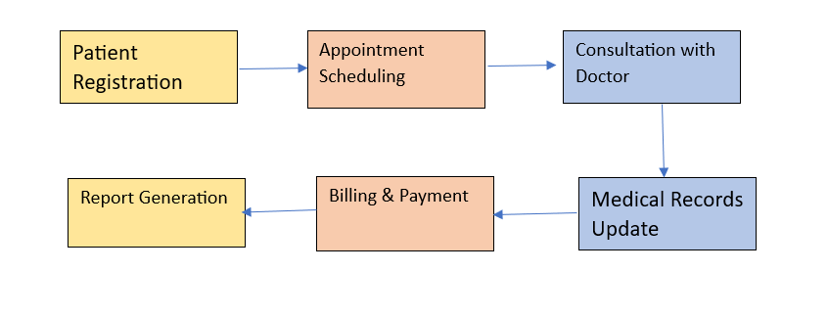
Workflow

Slide 10
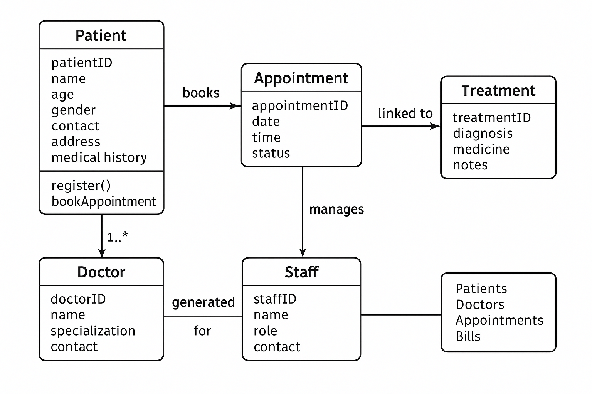
System Architecture

Slide 11
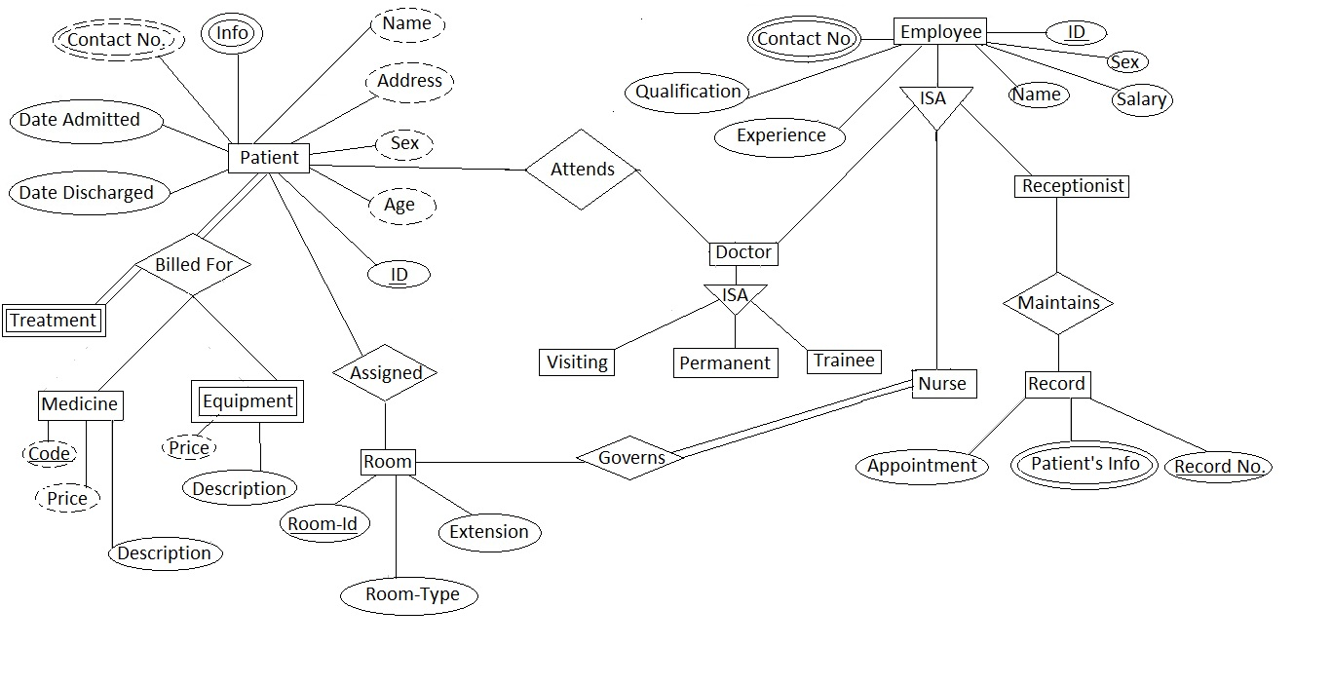
ER Diagram

Slide 12
Thank You
2410030076 – Kodali Naga Sreeja
2410030228 – Bijju Adithi Yadav
2410030229 – Likitha Thumma
2410030232 – H. Esha Manogna
2410030430 – Malreddy Manogna

